Slide 1
LECTURE ID : 18B11CS311STL01 PROGRAMME : B.Tech. COURSE TITLE : Computer Networks and Internet of Things LECTURE TITLE : Fundamentals of Routing FACULTY NAME : Dr. Shobhit Tyagi

Slide 2
Fundamentals of Routing
By Dr. Shobhit Tyagi Dept. of CSE & IT JIIT, NOIDA

Slide 3
Presentation Outline
Introduction to Router
Types of Routing
Routing Table and its Components
Types of Routing Protocols
Static Routing Protocol
Dynamic Routing Protocol
Internet Routing Protocols

Slide 4
Introduction to Routing
Routing is the process of selecting a path across one or more networks or subnetworks. The principles of routing apply to various types of networks, from telephone networks to public transportation systems.
In packet-switching networks, such as the Internet, routing determines the paths for Internet Protocol (IP) packets to travel from their origin to their destination.

Slide 5
Introduction to Routing
These Internet routing decisions are made by specialized network hardware called routers. A router is a networking device that forwards data packets between different computer networks or subnetworks. Routers connect to two or more IP networks or subnetworks and pass data packets between them as needed.

Slide 6
Routing
Routing is the process of determining the paths that data packets must follow to reach their destination. In this process, a routing table is created, which contains information about the available routes. Various routing algorithms are used to decide which route an incoming data packet should take to reach its destination efficiently.

Slide 7
Routing
Types of Routing
Static
Routing
Dynamic Routing
Default Routing

Slide 8
How does Routing Work ?
A router is a network device responsible for forwarding packets to their destinations. Routers use internal routing tables to make decisions about how to route packets along network paths.
A routing table records the paths that packets should take to reach every destination that the router manages. It is similar to a train timetable, which passengers use to decide which train to catch. Routing tables serve the same purpose for network paths as timetables do for trains.

Slide 9
How does Routing Work ?
Routers operate as follows: when a router receives a packet, it examines the packet’s header to determine its intended destination, similar to how a train conductor might check a passenger's ticket to decide which train they should board. The router then routes the packet based on information in its routing tables.
Routers perform this process millions of times per second with countless packets. As a packet travels to its destination, it may be routed multiple times by different routers.

Slide 10
Introduction to Routing
Consider the image below. To get from Computer A to Computer B, should the data packet pass through networks 1, 3, and 5, or through networks 2 and 4?
The packet will take a shorter path through networks 2 and 4. However, networks 1, 3, and 5 might be faster at forwarding packets. The IP router, after consulting its routing table, decides which network path is best.

Slide 11

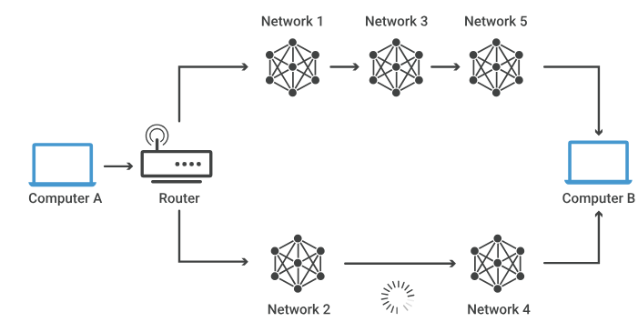
Introduction to Routing
Network 1
Network 3
Network 5
Computer A
Router
Computer B
Network 2
Network 4

Slide 12
Routing Tables
Routing tables are a fundamental component of networking, used by routers and other network devices to determine the best path for forwarding packets to their destinations.
A routing table is a data structure stored in a router or a network host that lists paths (routes) to specific network destinations.

Slide 13
Routing Tables
It holds information about:
Destination IP addresses or networks
Next-hop addresses (i.e., where to send the packet next)
Routing metrics (e.g., number of hops, link cost, etc.)
Interface (the network interface through which to forward the packet)
Subnet mask (to determine the range of IP addresses covered)
Distance to the destination

Slide 14
Component of Routing Tables
Destination: The IP address or network prefix of the destination network.
Next Hop: The IP address of the next router or gateway to which the packet should be sent.
Metric: A value used to determine the best path (e.g., distance, bandwidth, or cost)
Interface: The specific interface or port through which the router should forward the packet.

Slide 15
Component of Routing Tables
Interface: The specific interface or port through which the router should forward the packet.
Flags: These are special parameters that include:
U: Route is up (functional)
G: Uses a gateway
H: Target is host
D: Dynamically created route

Slide 16
Example of Routing Tables
Destination | Gateway | Genmask | Flags | Metric | Ref | Use | Interface
192.168.1.0 | 0.0.0.0 | 255.255.255.0 | U | 0 | 0 | 0 | eth0
10.0.0.0 | 192.168.1.1 | 255.0.0.0 | UG | 0 | 0 | 0 | eth1
0.0.0.0 | 192.168.1.1 | 0.0.0.0 | UG | 0 | 0 | 0 | eth0
In this example:
192.168.1.0/24 is directly connected to eth0.
Traffic for 10.0.0.0/8 is forwarded to the gateway 192.168.1.1.
The default route (0.0.0.0) sends all other traffic to the same gateway.

Slide 17
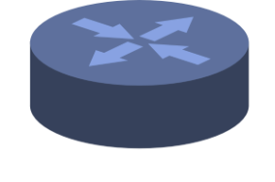
Types of Routes in a Routing Table
There are three types of routes in a routing table:
Directly Connected Routes: These are routes that are directly connected to the router’s interfaces.
Static Routes: These routes are manually configured by network administrators or users. They work well with small networks or topologies. Ex – Flooding.
Point to point
connection
Rout to this
Way only, no need
For update

Slide 18
Types of Routes in a Routing Table
Dynamic Routes: Learned through routing protocols such as RIP, OSPF, and BGP.
The network protocol adjusts automatically to changes in topology or traffic.
Unix hosts run routing daemons like routed or gated.
The routing protocol maintains and distributes routing information.

Slide 19
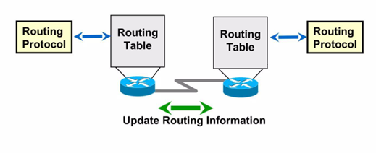
Types of Routes in a Routing Table
Routing Protocol
Routing Table
Routing Table
Routing Protocol
Update Routing Information

Slide 20
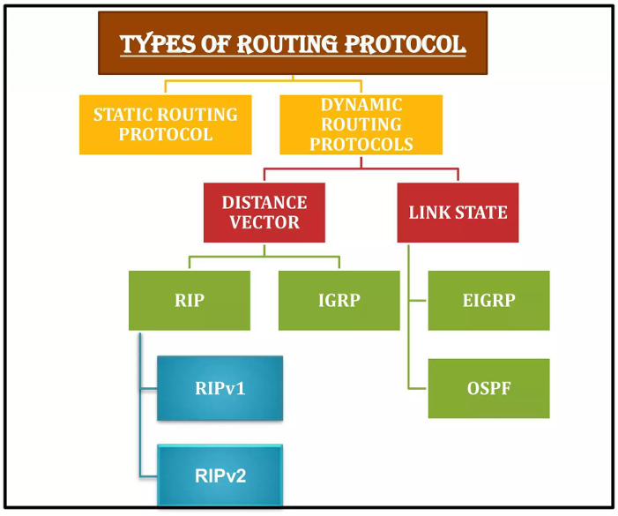
Types of Routing Protocol
Types of Routing Protocol
Static Routing Protocol
Dynamic Routing Protocols
Distance Vector
Link State
RIP
IGRP
EIGRP
RIPv1
OSPF
RIPv2

Slide 21
Types of Routing
Routing tables can be either static or dynamic:
Static Routing Tables: These do not change automatically. A network administrator manually sets up static routing tables, which determines the routes data packets take across the network. The routes remain fixed unless the administrator manually updates the tables.

Slide 22
Types of Routing
Dynamic Routing Tables: These update automatically. Dynamic routers use various routing protocols (see below) to determine the shortest and fastest paths.
This also takes into account the time it takes for packets to reach their destination, similar to how Google Maps, Waze, and other GPS services determine the best driving routes based on past driving performance and current conditions.
This requires more computing power, which is why smaller networks may rely on static routing. However, for medium-sized and large networks, dynamic routing is generally much more efficient.

Slide 23
Key Features and Use Case for Static Routing
Key Features of Static Routing:
Simplicity: Easy to configure, especially in small networks.
No Overhead: Since routes are predefined, no bandwidth is used for routing updates.
High Control: Administrators can dictate exact paths for traffic. However, the administrator must manually update all routers periodically.

Slide 24
Key Features and Use Case for Static Routing
Use Cases for Static Routing:
Small Networks: Ideal for networks with a simple topology that doesn’t change frequently.
Backup Routes: Static routes can serve as backup routes if dynamic routing fails.
Tight Security Requirements: Preferred in situations with high security needs, as they do not involve dynamic updates that could be exploited.

Slide 25
Dynamic Routing
Dynamic Routing: Allows routers to automatically discover and maintain routing information through routing protocols.
Routing Protocols: These protocols enable routers to exchange information to learn the best paths to network destinations. All routers must use the same dynamic routing protocol to exchange routes. When a router changes in condition or topology, it broadcasts this information to all other routers.

Slide 26
Dynamic Routing
Advantages :
Less effort is needed to maintain configurations when adding or removing networks.
Protocols automatically adjust to topology changes, making routing more scalable.
Disadvantages:
Router use additional resources for dynamic routing.
Requires more administrator knowledge for proper configuration.

Slide 27
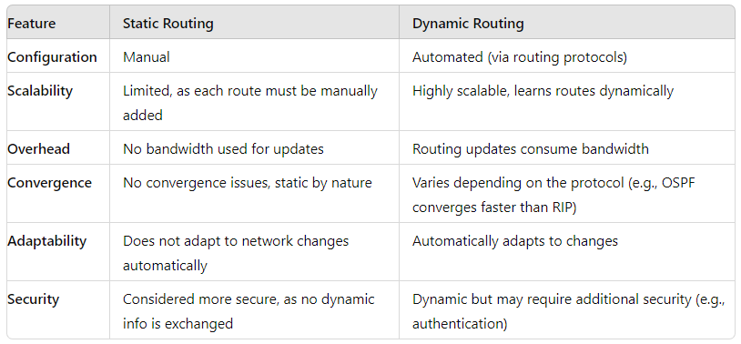
Static vs Dynamic Routing
Feature | Static Routing | Dynamic Routing
Configuration | Manual | Automated (via routing protocols)
Scalability | Limited, as each route must be manually added | Highly scalable, learns routes dynamically
Overhead | No bandwidth used for updates | Routing updates consume bandwidth
Convergence | No convergence issues, static by nature | Varies depending on the protocol (e.g., OSPF converges faster than RIP)
Adaptability | Does not adapt to network changes automatically | Automatically adapts to changes
Security | Considered more secure, as no dynamic info is exchanged | Dynamic but may require additional security (e.g., authentication)

Slide 28
Types of Dynamic Routing
Dynamic routing protocols can be categorized based on various parameters. They are generally classified into two types:
Distance Vector Routing Protocols: These protocols use simple algorithms to calculate the cumulative distance between routers based on hop count. Example include:
Routing Information Protocol (RIP)
Interior Gateway Routing Protocol (IGRP)

Slide 29
Types of Dynamic Routing
Link State Routing Protocols: These protocols use sophisticated algorithms to maintain a detailed database of the network’s topology. Example include:
Enhanced Interior Gateway Routing Protocol (EIGRP)
Open Shortest Path First (OSPF)

Slide 30
Link State Routing
Link State Routing is a technique where each router shares information about its local network (neighborhood) with every other router in the internetwork.
Three key aspects of the Link State Routing algorithm:
Knowledge about the Neighborhood: Instead of sending its entire routing table, a router shares information only about its local neighborhood. Its broadcasts its identity and the cost of directly connected links to other routers.

Slide 31
Link State Routing
Flooding: Each router sends the information to every other router in the internetwork except its immediate neighbors. This process, known as flooding, ensures that every router eventually receives a copy of the information. Each router that receives the packet forwards copies to all its neighbors.
Information Sharing: A router sends updated information to every other router only when a change occurs in its own routing information.

Slide 32
Link State Routing
Link-state routing is the second family of routing protocols.
While distance-vector routing protocols use distributed algorithms to compute routing tables, link-state routing protocols involve link-state routers exchanging messages that allow each router to learn the entire network topology.
Based on this learned topology, each router can then compute its routing table using shortest path algorithms.

Slide 33
Link State Routing
Protocols of Link-State Routing:
Open Shortest Path First (OSPF)
Intermediate System to Intermediate System (IS-IS)
Calculation of Shortest Path:
To determine the shortest path, each node uses Dijkstra algorithm.

Slide 34
Distance Vector Routing (DVR) Protocol
In distance-vector routing (DVR), each router periodically informs its neighboring routers of topology changes. Historically, this approach is known as the ARPNET routing algorithm or Bellman-Ford algorithm.
In DVR, each router maintains a routing table with one entry per destination. Each entry includes a preferred outgoing line to use for that destination and an estimate of the time (delay) to reach it. The tables are updated by exchanging information with neighboring routers.
Each router knows the delay to its neighbors (e.g., by sending echo requests).

Slide 35
How the DVR Protocol Works
Routers periodically exchange routing tables with their neighbors.
Each router compares the delay in its local table with the delay in the neighbor’s table and the cost of reaching that neighbor.
If the path through the neighbor offers a lower cost, the router updates its local table to forward packets via the neighbor.

Slide 36
Distance Vector Routing (DVR) Protocol
Distance Vector Routing Algorithm
Let dx(y) be the cost of the least-cost path from node x to node y. The least costs are related by the Bellman-Ford equation:
dx(y) = minv{c(x,v) + dv(y)}
Where the minimum is taken over all neighbors v of node x. After traveling from x to v, if we consider the least-cost path from v to y, the path cost will be c(x,v) + dv(y). The least cost from x to y is the minimum of c(x,v) + dv(y) taken over all neighbors v.

Slide 37
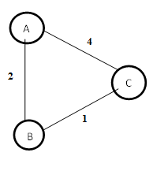
Distance Vector Routing (DVR) Protocol
Example: Distance Vector Router Protocol
In the network shown below, there are three routers: A, B, and C.
Step 1 − In this DVR network, each router shares its routing table with every neighbor. For example, Router A will share its routing table with neighbors B and C and, while Routers B and C will share their routing tables with A.
A
4
2
C
B
1

Slide 38
Distance Vector Routing (DVR) Protocol
Form A | A | B | C
A | 0 | 2 | 3
B
C
Form B | A | B | C
A
B | 2 | 0 | 1
C
Form C | A | B | C
A
B
C | 4 | 1 | 0

Slide 39
Distance Vector Routing (DVR) Protocol
Step 2 − If the path via a neighbor has a lower cost, the router updates its local table to reflect this. For instance, if Router A finds a lower cost path to Router C through Router B, it updates its table to reflect the new cost. The router adjusts the weight from 4 to 3 for both Router A and C accordingly.
Form C | A | B | C
A
B
C | 3 | 1 | 0

Slide 40
Distance Vector Routing (DVR) Protocol
Step 3 − The final updated routing table, reflecting the lower cost distance vector routing protocol for all routers A, B, and C is shown below :
Form A | A | B | C
A | 0 | 2 | 3
B | 2 | 0 | 1
C | 3 | 1 | 0
Form B | A | B | C
A | 0 | 2 | 3
B | 2 | 0 | 1
C | 3 | 1 | 0

Slide 41
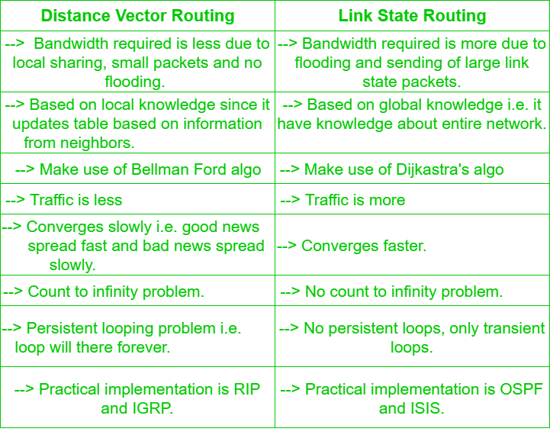
Distance Vector Routing (DVR) Protocol
Distance Vector Routing | Link State Routing
Bandwidth required is less due to local sharing, small packets and no flooding. | Bandwidth required is more due to flooding and sending of large link state packets.
Based on local knowledge since it updates table based on information from neighbors. | Based on global knowledge i.e. it have knowledge about entire network.
Make use of Bellman Ford algo | Make use of Dijkastra's algo
Traffic is less | Traffic is more

Slide 42
Distance Vector Routing (DVR) Protocol
Distance Vector Routing | Link State Routing
Converges slowly i.e. good news spread fast and bad news spread slowly. | Converges faster.
Count to infinity problem. | No count to infinity problem.
Persistent looping problem i.e. loop will there forever. | No persistent loops, only transient loops.
Practical implementation is RIP and IGRP. | Practical implementation is OSPF and ISIS.

Slide 43
Dynamic Routing Protocols
Common Dynamic Routing Protocols:
RIP (Routing Information Protocol): The Routing Information Protocol (RIP) uses "hop count" to determine the shortest path from one network to another, where "hop count" refers to the number of routers a packet must pass through on its way to the destination (with a maximum limit of 15 hops).

Slide 44
Dynamic Routing Protocols
Each time a packet travels from one network to another, it is considered a "hop.“
Simple but not suitable for large networks due to the hop count limit.
Updates are shared every 30 seconds, which can lead to inefficient routing in larger networks.

Slide 45
RIP
Routing Information Protocol (RIP) is a dynamic routing protocol that uses hop count as its routing metric to determine the best path between the source and destination networks.
It is a distance-vector routing protocol with an administrative distance (AD) value of 120 and operates at the Network layer of the OSI model. RIP uses port number 520.

Slide 46
RIP
Hop Count:
Hop count is the number of routers encountered between the source and destination networks. The path with the lowest hop count is considered the best route and is therefore placed in the routing table.
RIP prevents routing loops by limiting the number of hops allowed in a path between the source and destination.
The maximum hop count allowed in RIP is 15, and a hop count of 16 is considered to indicate that the network is unreachable.

Slide 47
RIP
Features of RIP:
Network updates are exchanged periodically.
Updates (routing information) are broadcast to all routers in the network.
Full routing tables are sent in each update.
Routers trust the routing information received from neighbor routers; a practice known as “routing on rumors”.

Slide 48
RIP
How RIP Works:
If there are 8 routers in a network and Router 1 wants to send data to Router 3, RIP will select the route with the fewest number of hops. Suppose there are three possible routes from Router 1 to Router 3: Route1, Route 2, and Route 3.
Route 1 has 3 hops.
Route 2 has 2 hops.
Route 3 has 4 hops.
In this case, RIP will choose Route 2, as it has the least number of hops (2), making it the most efficient route.

Slide 49
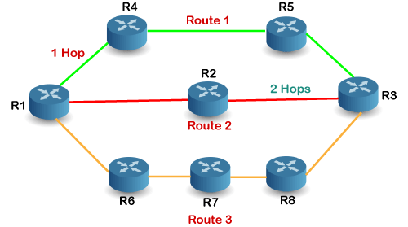
RIP
R4
R5
Route 1
1 Hop
R2
2 Hops
R1
R3
Route 2
R6
R7
R8

Slide 50
Dynamic Routing
OSPF (Open Shortest Path First): The OSPF protocol is widely used by network routers to dynamically determine the fastest and shortest routes for sending packets to their destination.
It is a link-state protocol, meaning each router builds a comprehensive map of the network.
It uses cost (based on bandwidth) as its metric for determining the best route.
OSPF is suitable for large, complex networks due to its faster convergence and scalability.
It supports hierarchical design with areas to limit the amount of routing information shared throughout the network.

Slide 51
Open Shortest Path First (OSPF)
Open Shortest Path First (OSPF) is a link-state routing protocol that determines the best path between the source and destination routers using its own Shortest Path First (SPF) algorithm.
A link-state routing protocol, such as OSPF, uses triggered updates. This means that updates are sent only when, there is a change in the network topology, unlike distance-vector routing protocols, where the routing table is exchanged periodically.

Slide 52
Open Shortest Path First (OSPF)
Open Shortest Path First (OSPF) is a link-state routing protocol used to find the best path between source and destination routers using its own Shortest Path First (SPF) algorithm.
OSPF was developed by the Internet Engineering Task Force (IETF) as one of the Interior Gateway Protocol (IGPs). IGPs are protocols designed to manage routing within a large autonomous system or routing domain.

Slide 53
Open Shortest Path First (OSPF)
OSPF is a network layer protocol that operates with protocol number 89 and has an administrative distance (AD) value of 110. It uses the multicast address 224.0.0.5 for normal communication and 224.0.0.6 for updates specifically to the Designated Router (DR) and Backup Designated Router (BDR).
To manage routing efficiently and in a timely manner, OSPF divides an autonomous system into areas. An area is a collection of routers, hosts and networks all contained within the autonomous system.
An autonomous system can be divided into multiple areas, but all networks within a single area must be interconnected.

Slide 54
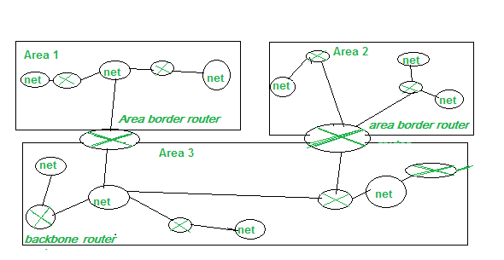
Open Shortest Path First (OSPF)
Area 1
Area 2
net
net
net
net
Net
net
Area border router
area border router
Area 3
net
net
net
backbone router
net

Slide 55
Open Shortest Path First (OSPF)
Working of OSPF:
The operation of the OSPF protocol can be understood in the following steps:
Step 1: The first step in the OSPF protocol’s operation is establishing neighbor relationships. Routers running OSPF on the same link will establish a neighbor relationship with each other.

Slide 56
Open Shortest Path First (OSPF)
Step 2: The next step is to exchange database information between the routers. Once a neighbor relationship is established, the routers exchange their Link-State Databases (LSDBs) with each other.
Step 3: The final step is to select the best route. After exchanging LSDB information, each router calculates the best route to add to its routing table based on the updated database.

Slide 57
Dynamic Routing
BGP (Border Gateway Protocol): The Border Gateway Protocol (BGP) is used to announce which networks control specific IP addresses and how these networks are connected.
The large networks that make these BGP announcements are known as autonomous systems. BGP is a dynamic routing protocol.
BGP is used for routing between different autonomous systems (AS), such as between Internet Service Providers (ISPs).
It is highly scalable and complex, utilizing path vectoring and policy-based routing.
BGP is crucial for the backbone of the internet, playing a key role in global routing.

Slide 58
Border Gateway Protocol (BGP)
BGP (Border Gateway Protocol) is a standardized gateway protocol used to exchange routing information across autonomous systems (AS). When a network router is connected to multiple networks, it cannot independently determine the best network to route its data to.
BGP evaluates all its peering partners and routes traffic to the path that is deemed the most efficient based on its routing policies and the network’s overall topology.

Slide 59
Border Gateway Protocol (BGP)
BGP enables communication by allowing peers to exchange routing information upon initialization and then storing that information in a Routing Information Base (RIB).
The primary goal of BGP is to find a loop-free path to the destination. This differs from the typical goals of intradomain routing protocols, which focus on finding the optimal route based on specific link metrics.

Slide 60
Border Gateway Protocol (BGP)
Routers that connect different autonomous systems (ASs) are called border gateways. Their primary task is to forward packets between ASs. Each AS has at least one BGP speaker, which exchanges reachability information with BGP speakers in other ASs.

Slide 61
Border Gateway Protocol (BGP)
Types of BGP:
Internal BGP (iBGP):
Routes are exchanged and traffic is transmitted over the Internet using external BGP (eBGP). Autonomous Systems (ASs) can also use an internal version of BGP, known as internal BGP (iBGP), to route traffic within their internal networks.
It is important to note that using internal BGP (iBGP) is not a requirement for using external BGP (eBGP). Autonomous Systems have the option to use various internal protocols to connect the routers within their internal networks.

Slide 62
Border Gateway Protocol (BGP)
External BGP (eBGP):
External BGP (eBGP) is similar to international shipping, where specific standards and guidelines must be followed to ensure that a package reaches its destination country. Once the package arrives in the destination country, it is then handled by the local mail service to reach its final destination.

Slide 63
Border Gateway Protocol (BGP)
Just as each country has its own internal mail service that may not follow the same guidelines as other countries, each autonomous (AS) can use its own internal routing protocol for managing data within its network.
Similarly, while eBGP handles routing between different Ass, each AS may have its internal routing protocols for managing traffic within its network.

Slide 64
Dynamic Routing
EIGRP (Enhanced Interior Gateway Routing Protocol):
EIGRP is a Cisco proprietary protocol, that combines features of both distance-vector and link-state protocols.
It uses a combination of bandwidth, delay, load, and reliability to calculate the best route.
EIGRP is known for its fast convergence and high scalability.

Slide 65
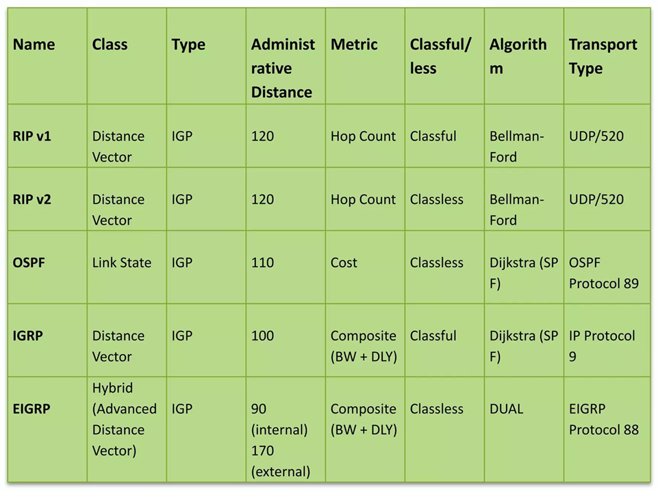
Routing Protocols Comparison
Name | Class | Type | Administrative Distance | Metric | Classful/ less | Algorithm | Transport Type
RIP v1 | Distance Vector | IGP | 120 | Hop Count | Classful | Bellman-Ford | UDP/520
RIP v2 | Distance Vector | IGP | 120 | Hop Count | Classless | Bellman-Ford | UDP/520
OSPF | Link State | IGP | 110 | Cost | Classless | Dijkstra (SPF) | OSPF Protocol 89
IGRP | Distance Vector | IGP | 100 | Composite (BW + DLY) | Classful | Dijkstra (SPF) | IP Protocol 9
EIGRP | Hybrid (Advanced Distance Vector) | IGP | 90(internal) 170(external) | Composite (BW + DLY) | Classless | DUAL | EIGRP Protocol 88

Slide 66
Thank You

